Slide 1

Project 3:
Chicago Energy Benchmarking
Kevin Denning, Camille Jensen, Rebecca Levine, Heather Robson, Bakari Simmons

Slide 2
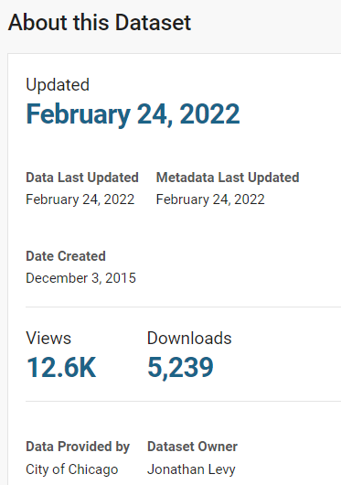
Data Source
Chicago Energy Benchmarking:
“The Chicago Building Energy Use Benchmarking Ordinance calls on existing municipal, commercial, and residential buildings larger than 50,000 square feet to track whole-building energy use, report to the City annually, and verify data accuracy every three years. The law, which was phased in from 2014-2017, covers less than 1% of Chicago’s buildings, which account for approximately 20% of total energy used by all buildings.”
Levy, J. (2015, March 12). Chicago Energy Benchmarking | City of Chicago | Data Portal. Data.cityofchicago.org; City of Chicago. https://data.cityofchicago.org/Environment-Sustainable-Development/Chicago-Energy-Benchmarking/xq83-jr8c

Slide 3
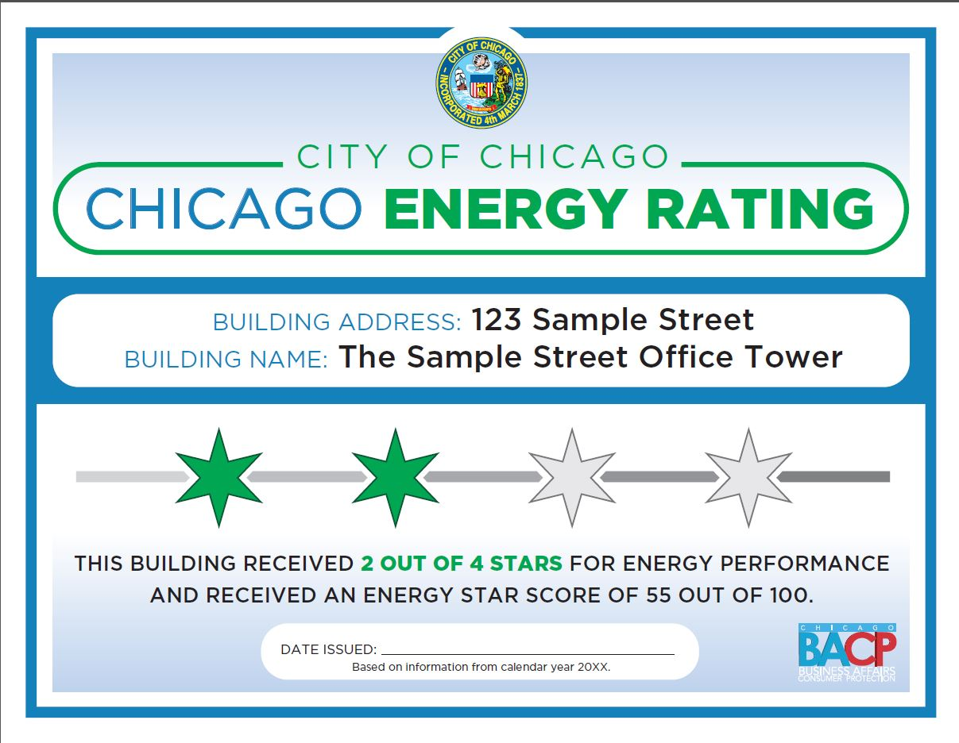
What is the Chicago Energy Rating system?
“The Chicago Energy Rating system started in 2019 for buildings required to benchmark and report their energy use (which includes most properties that are 50,000 square feet or larger in size located in the City of Chicago).
Ratings are assigned and then provided on a Chicago Energy Rating Placard, which is mailed to each building. The Placard must be posted in a prominent location and shared at the time the property is listed for sale or lease.”
-Chicago Energy Rating. (n.d.). Retrieved from www.chicago.gov website: https://www.chicago.gov/city/en/progs/env/ChicagoEnergyRating.html

Slide 4
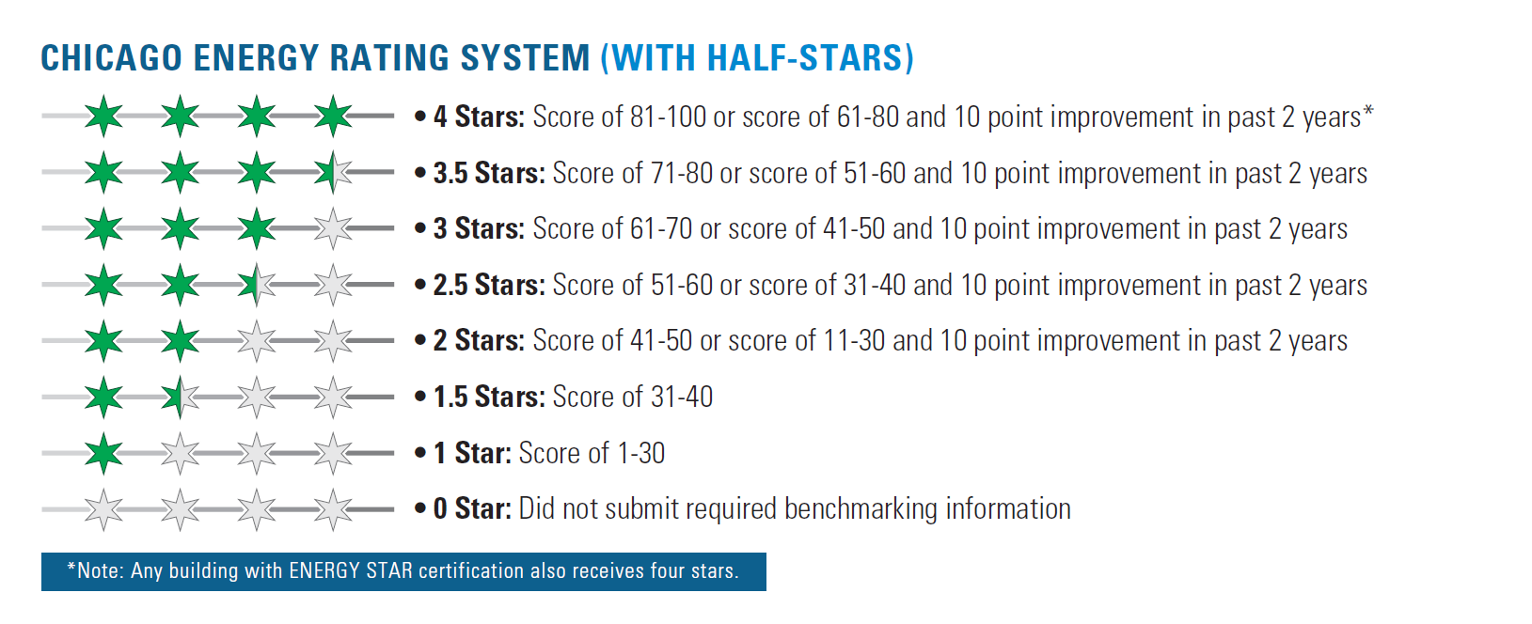
-Chicago Energy Rating. (n.d.). Retrieved from www.chicago.gov website: https://www.chicago.gov/city/en/progs/env/ChicagoEnergyRating.html
Notes:
Rating system does take prior years into consideration
From site:
A rating of four stars indicates the highest energy performance, while a rating of one star indicates a poor performer. Properties that have not submitted required energy information will receive zero out of four stars. Any property that improves can earn an additional star, although improvements are not required by the City. Scroll down to read more details.

Slide 5
Most Relevant Variables
Column Name | Type | Description
Data Year | Int | Calendar Year
Chicago Energy Rating | Int | The zero-to-four-star Chicago Energy Rating assigned to the building in the shown Data Year
Exempt From Chicago Energy Rating | String | Shows whether the building is subject to the Chicago Energy Rating Ordinance
Community Area | String | The Chicago community area where the property is located
Primary Property Type | String | The primary use of a property (e.g. office, retail store)
Water Use (kGal) | Int | Water use for the data year in thousands of gallons from 2018 and on
ENERGY STAR Score | Int | 1-100 rating that assesses a property’s overall energy performance, based on national data to control for differences among climate, building uses, and operations
Electricity Use (kBtu) | Int | The annual amount of electricity consumed by the property on-site
Total GHG Emissions (Metric Tons CO2e) | Int | The total amount of greenhouse gas emissions, including carbon dioxide, methane, and nitrous oxide gases released into the atmosphere as a result of energy consumption at the property, measured in metric tons of carbon dioxide equivalent
Row_ID | String | A unique ID for the row, made up of the combination of the Data Year and ID

Slide 6
Data Collection and Preparation
Data Collection
Data was downloaded from the source as a CSV and uploaded into Jupyter Notebooks for initial processing
Data Cleaning
Collected general information about data content and structure
Dropped all rows that were 'Exempt' for their 'Reporting Status' as these buildings did not submit any reports to be included in the data set
Identified rows containing null values, and filled in with 'NaN' in order to appropriately upload our data to our SQL database
Explored relationships between variables; ex. grouped our data by building in unique 'Community Areas' in order to compare energy usage amongst Chicago's neighborhoods

Slide 7
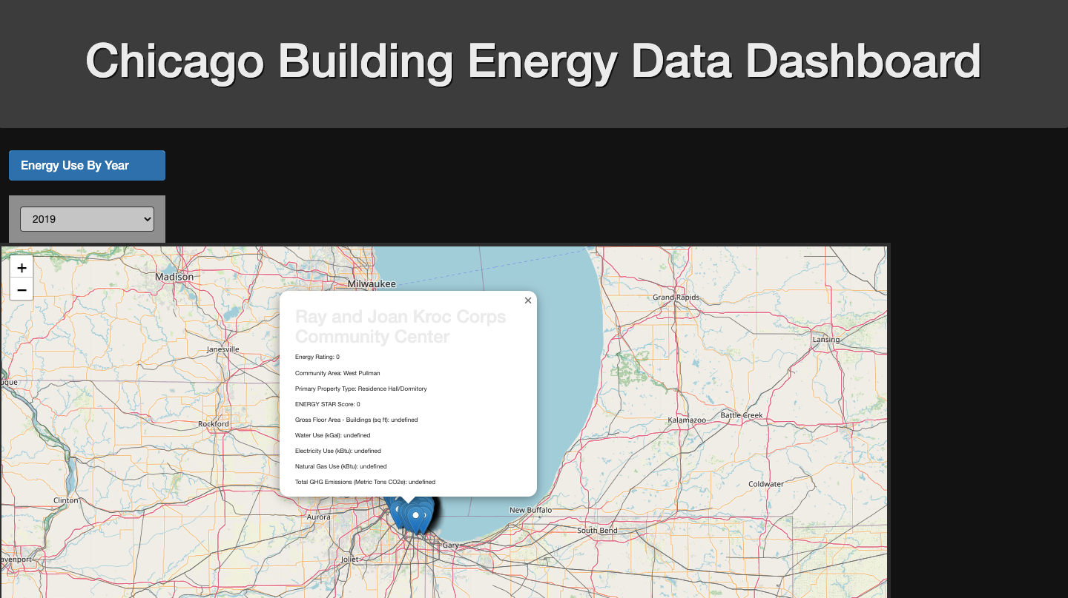
Visualizations
The map above indicates the geographical location of each building that reported their energy use. The drop-down allows the user to select the specific year of the data they are looking for.

Slide 8
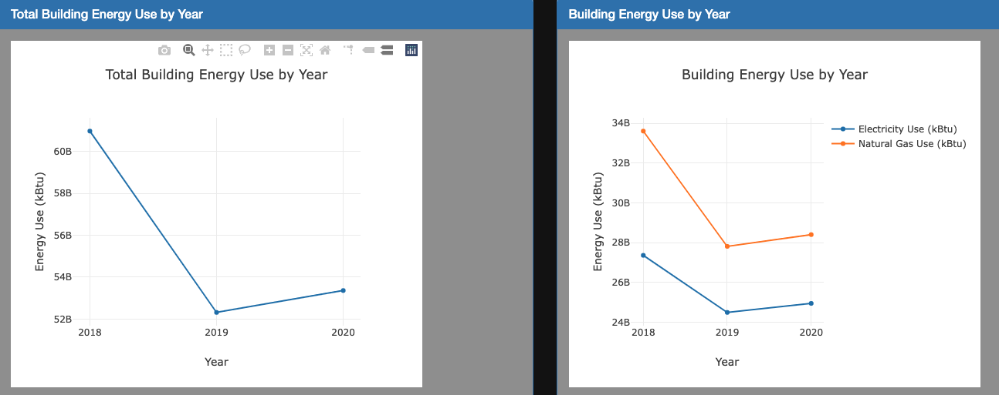
Visualizations
The line graphs above illustrates the average electricity use (kBtu), natural gas use (kBtu) for all reporting buildings annual submissions from 2018-2020.

Slide 9
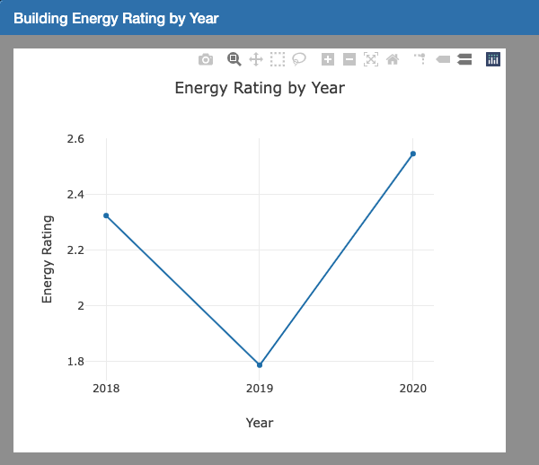
Visualizations
The line chart above shows the average Chicago Energy Star rating for the all reporting buildings over the years 2018-2020. The higher the energy rating, the better the energy performance.

Slide 10
Conclusions
The drop down menu allows users to select specific buildings included in the data set.
The line graph indicates the energy consumption in terms of electricity, natural gas, and ghg emissions for the selected building.
The gauge shows the average energy star rating over each reporting year for the building.
We can compare energy consumption to energy star rating.
The heat map illustrates the cities community areas with the greatest number of reporting buildings, as well as shows the demographics of each.

Slide 11
Limitations/Other Directions
JSON difficulties led us to take the URL from the source rather than populate our dashboard with our cleaned data version
The way the JSON exports, we were unable to index into individual buildings, and rather had to analyze the dataset as a whole

